Slide 1
Cognitive Aspects
Samia Arshad
Computer Science Department

Slide 2
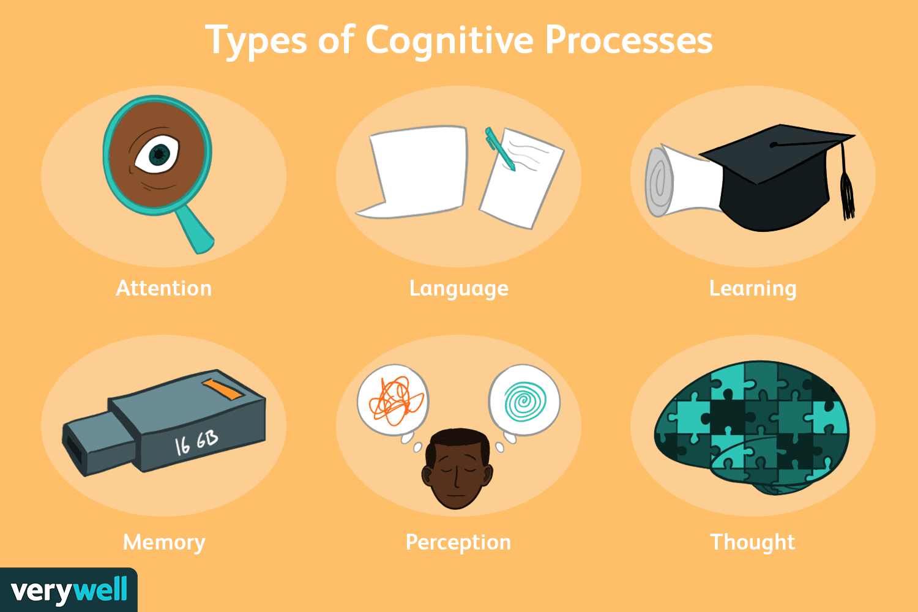
What is Cognition?
The mental action or process of acquiring knowledge and understanding through thought, experience, and the senses.

Slide 3

Experimental Cognition
Experimental Cognition is a state of mind where people perceive, act, and react to events around them intuitively and effortlessly. It requires reaching a certain level of expertise and engagement.
Examples include driving a car, reading a book, having a conversation, and watching a video.

Slide 4

Reflective Cognition
Reflective Cognition involves mental effort, attention, judgment, and decision-making, which can lead to new ideas and creativity.
Examples include designing, learning, and writing a report.
Fast Thinking
2*2 = ?
Slow Thinking
29*35 = ?

Slide 5
Cognition has also been described in terms of specific kinds of processes.
Attention
• Perception
• Memory
• Learning
• Reading, speaking, and listening
• Problem-solving, planning, reasoning, and decision-making

Slide 6
Attention
Attention is central to everyday life.
It involves selecting things on which to concentrate, at a point in time, from the range of possibilities available, allowing us to focus on information that is,relevant to what we are doing.
The extent to which this process is easy or difficult depends on
whether someone has clear goals and
whether the information they need is salient in the environment.

Slide 7
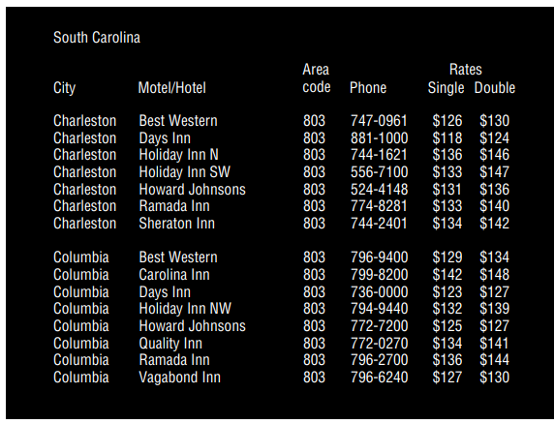

Attention
Clear Goals
Information Presentation
Multitasking and Attention

Slide 8
Design Implication: Attention
Consider context
Make information salient when it requires attention at a given stage of a task.
Use techniques to achieve this when designing visual interfaces.e.g. animations,coloring
Avoid cluttering visual interfaces with too much information. This applies especially to the use of color and graphics.
Consider designing different ways of supporting effective switching and returning to a particular interface.

Slide 9

Example

Slide 10
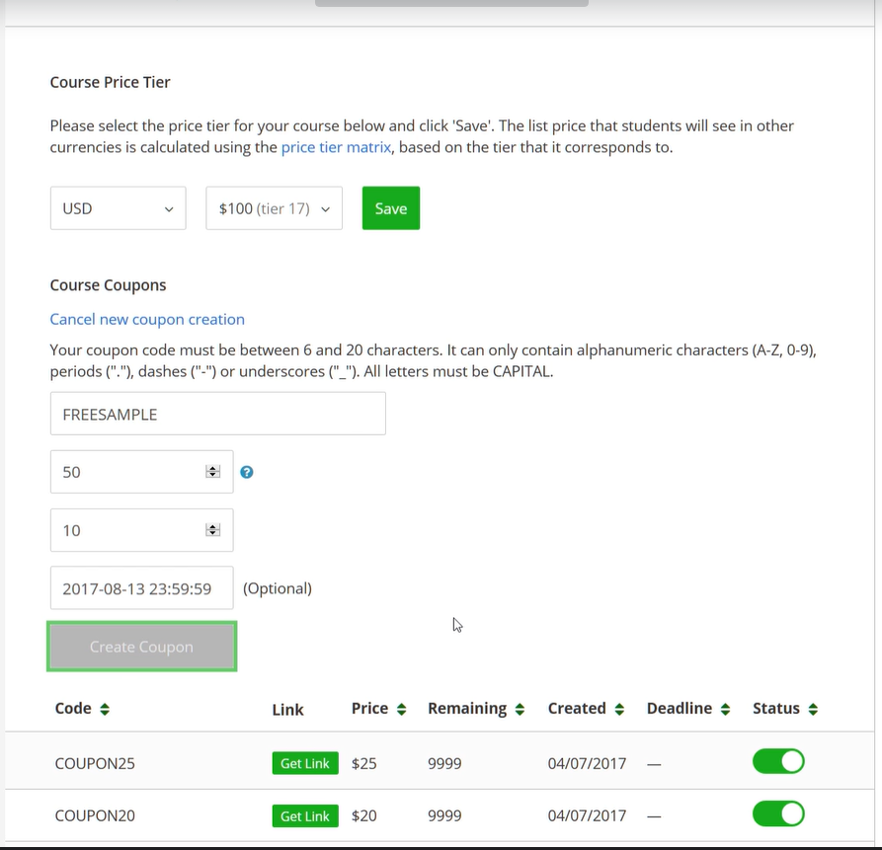

Example

Slide 11
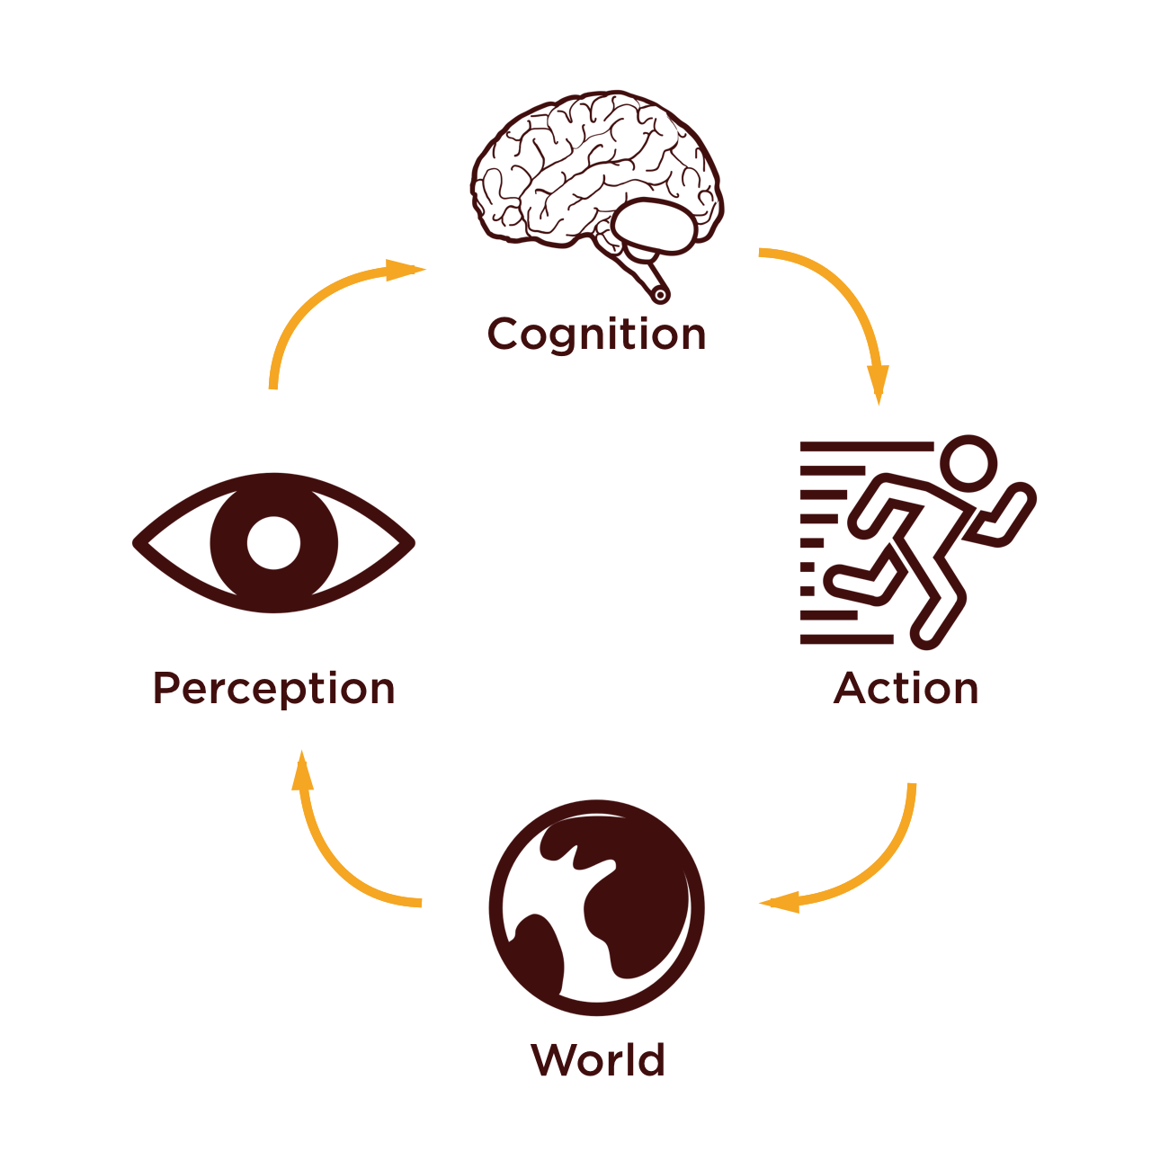
Perception
Perception refers to how information is acquired from the environment via the five senses and are transformed into experiences of objects, events, sounds, and tastes (Roth, 1986).
Additional sense of kinaesthesia,
relates to the awareness of
the position and movement of the
parts of the body through internal
sensory organs.

Slide 12
Design Implication: Perception
Representations of information need to be designed to be perceptible and recognizable across different media.
Design icons and other graphical representations.
Obvious separators and white space
Design audio
Research proper color contrast
Haptic feedback should be used judiciously.

Slide 13
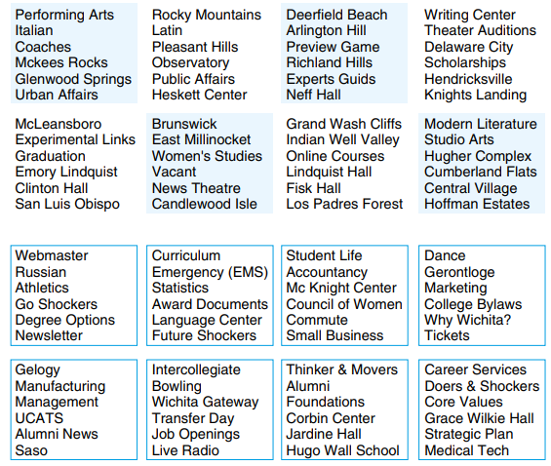
Examples

Slide 14
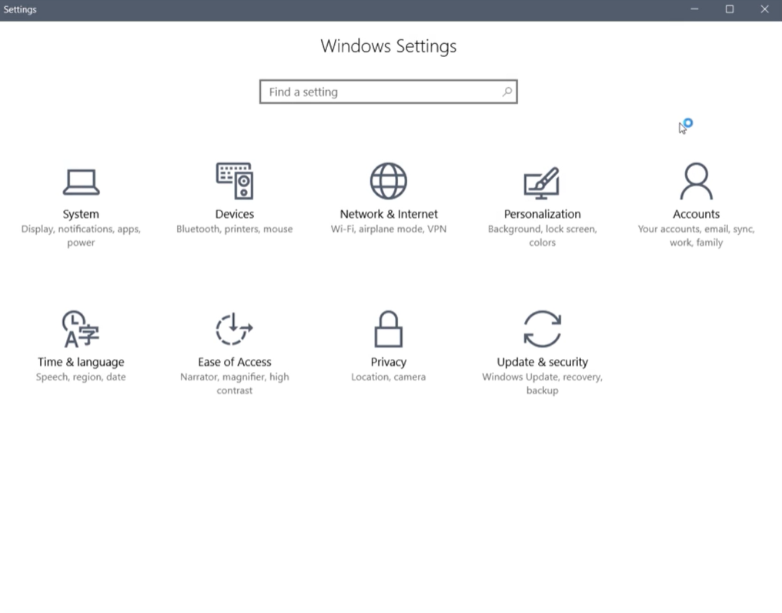
Example

Slide 15


Example
Samsung
Haier

Slide 16
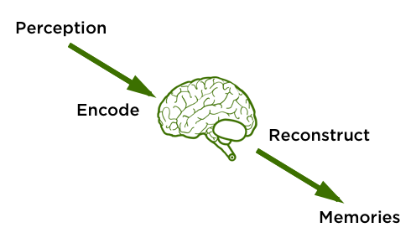
Memory
Memory involves recalling various kinds of knowledge that allow people to act appropriately.
Initially, encoding takes place, determining which information is paid attention to in the environment and how it is interpreted.
Recognition is better than
Recall.(e.g.pictures recog)

Slide 17
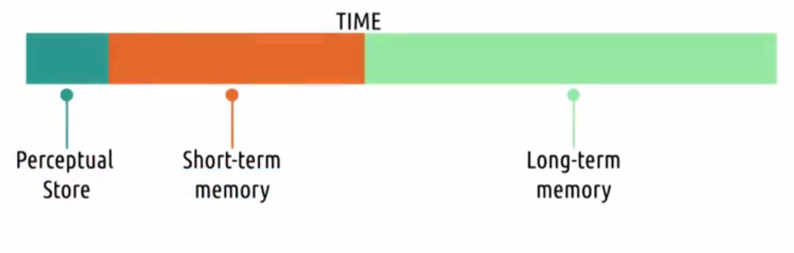
Memory
Short-term memory is the capacity to store a small amount of information in mind and keep it available for a short time.
Long-term memory refers to unlimited storage information to be maintained for long periods, even for life.

Slide 18

Personal Information Management
PIM concerns how people organize and maintain personal information collections, and methods that can help people in doing so.
Steve Whittaker, 2016 Model of PIM
How to decide what personal information to keep?
How to organize that information when sorting it?
Which strategies to use to retrieve it later

Slide 19
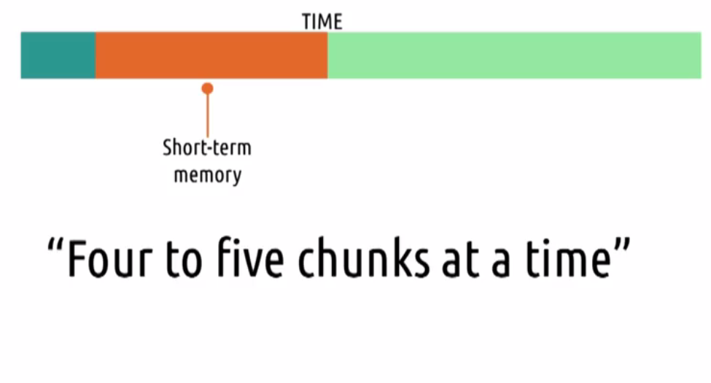
Memory Load and Password
Remembering small chunks of information that do not require frequent recall.

Slide 20
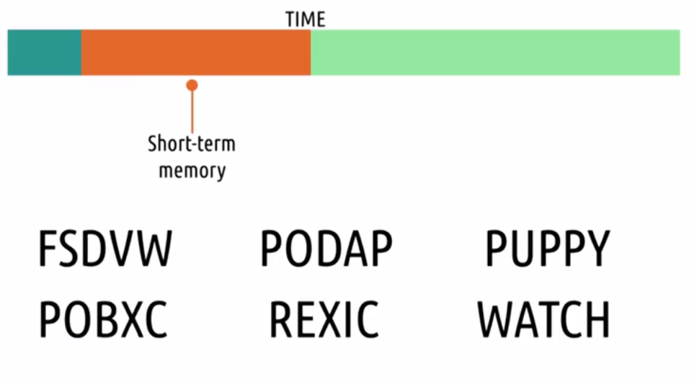
Memory Activity

Slide 21
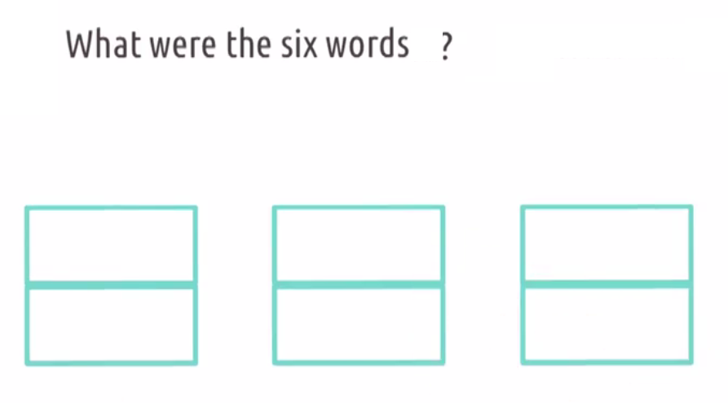
Solution

Slide 22
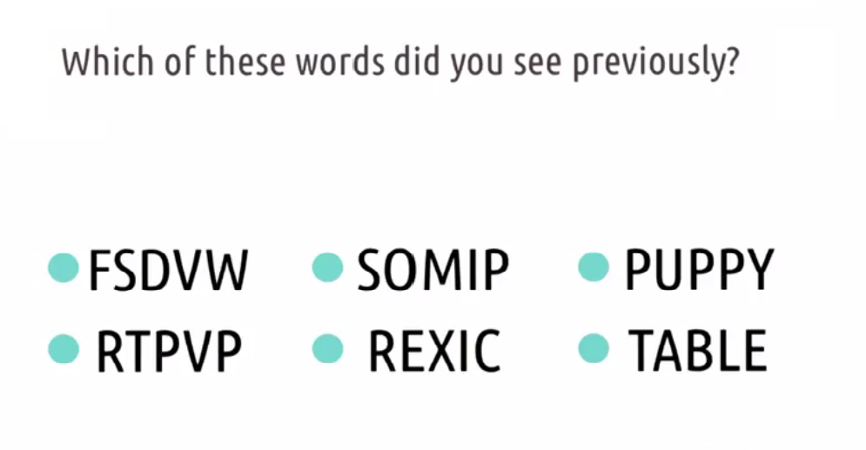
Short-Term Memory and Recognition

Slide 23
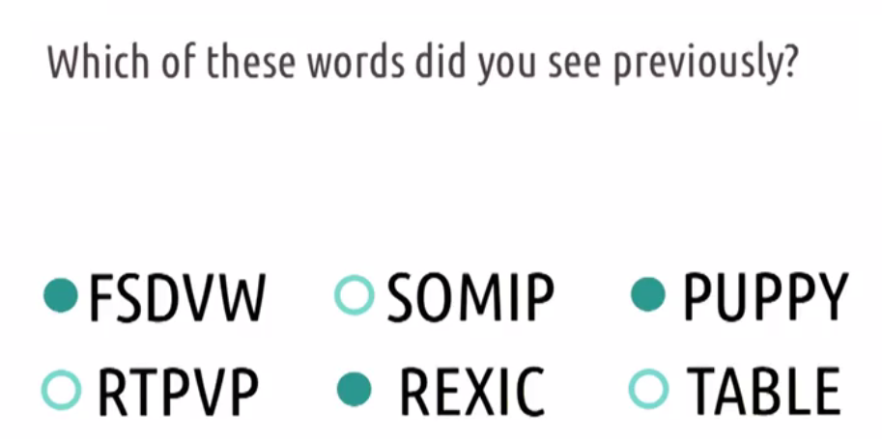
Solution

Slide 24
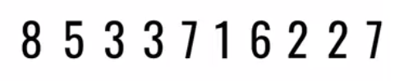
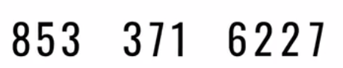
Short-Term Memory Takeaways

Slide 25
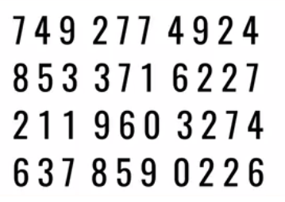
Short-Term Memory Takeaways

Slide 26

Learning
It involves the accumulation of skills and knowledge that would be impossible to achieve without memory.
Incidental Learning
occurs without any intention to learn
Intentional Learning
is goal-directed with the goal of being able to remember it

Slide 27
Design Implication : Learning
Design interfaces that encourage exploration.
Design interfaces that constrain and guide users to select appropriate actions when initially learning.

Slide 28
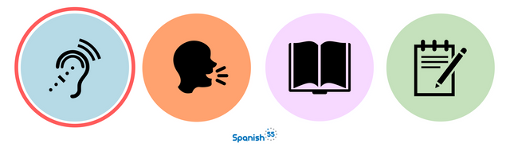
Reading, Speaking and Listening
Reading, speaking, and listening are three forms of language processing that have some similar and some different properties.
Written language is permanent while listening is transient
Written language tends to be grammatical
Reading can be quicker than speaking or listening
Listening requires less cognitive effort than reading or speaking

Slide 29
Design Implications : R,S & L
Keep the length of speech-based menus and instructions to a minimum.
Accentuate the intonation of artificially generated speech voices, as they are harder to understand than human voices.
Provide opportunities for making text large on a screen

Slide 30

Problem Solving, Planning, Reasoning and Decision Making
Problem-solving, planning, reasoning, and decision-making are processes involving reflective cognition.
They include thinking about what to do, what the available options are, and what the consequences might be of carrying out a given action.
This is assumed to involve exhaustively processing the information and making trade-offs between features.
This suggests that an effective design strategy is to make key information about a product highly salient.

Slide 31
Design Implications : PS, P, R & DM
Provide information and help pages
Use simple and memorable functions to support rapid decision-making and planning.
Enable users to set or save their own criteria or preferences.

Slide 32
Cognitive Frameworks
Mental model
Gulf of Evaluation and Execution
Information Processing
Distributed Cognition
External Cognition
Embodied Interactions

Slide 33
Mental Model
Metal Model
An internal, simulatable understanding of external reality
Simulated model helps you to make predictions and understands the real world around you
For example, when you bounce a ball

Slide 34
Mental Model
Make sure that user’s mental model matches the way our system work
Two ways to do this by designing systems
That act the way user expect them to act
That teach the user how they will act.

Slide 35
Mental Model and Education
Teaching analogy
Design interface that teach user while they are using it
Good representation show the user exactly how the system actually works.

Slide 36
Mental Model
Affordance
What the user can see that a object does
Mapping
Relation between control and their effects
Constraints
The state of being checked, restricted or compelled to avoid or perform some action.
Causality
The thing that happen right after an action is assumed by people to be caused by that action.

Slide 37
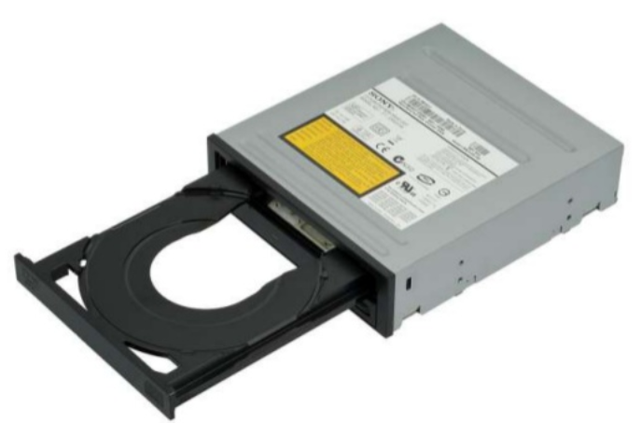

Affordance
Perceived affordance
Types of action user perceives to be possible
Real affordance
Actual actionable properties of object

Slide 38
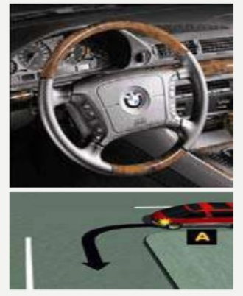
Mapping

Slide 39

Constraints

Slide 40
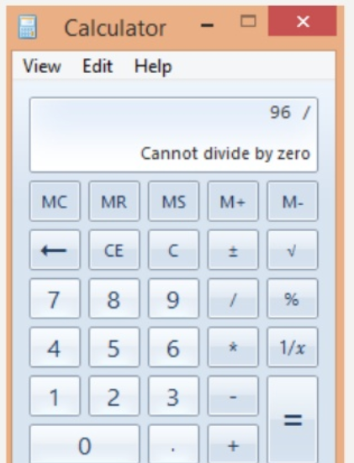
Constraints

Slide 41
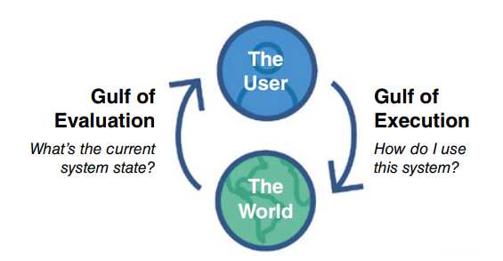
Gulf of Execution and Evaluation
The gulf of execution and the gulf of evaluation describe the gaps that exist between the user and the interface (Norman, 1986; Hutchins et al., 1986)
The gulfs are intended to show how to design the interface to enable the user to cope with them.

Slide 42
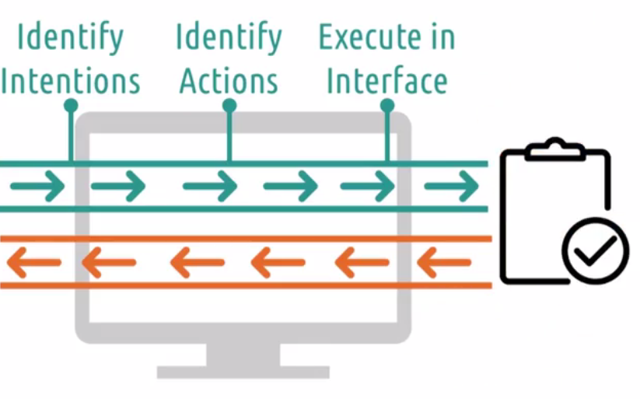

Gulf of Execution

Slide 43
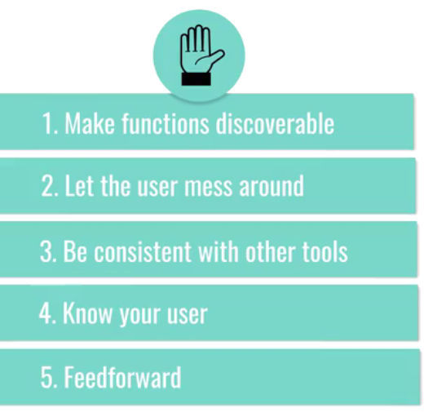
Tip to bridge GoExe

Slide 44
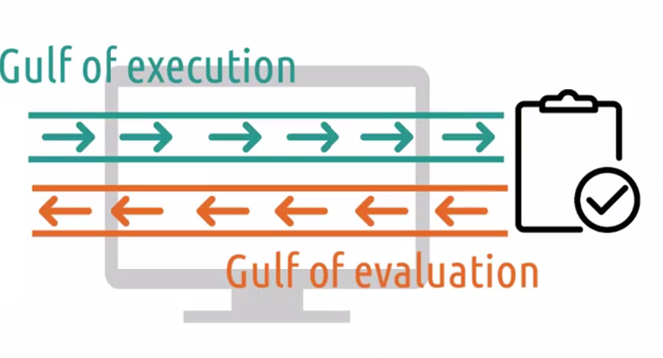
Gulf of Evaluation

Slide 45
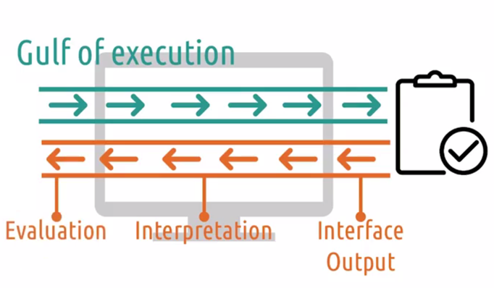
Components

Slide 46
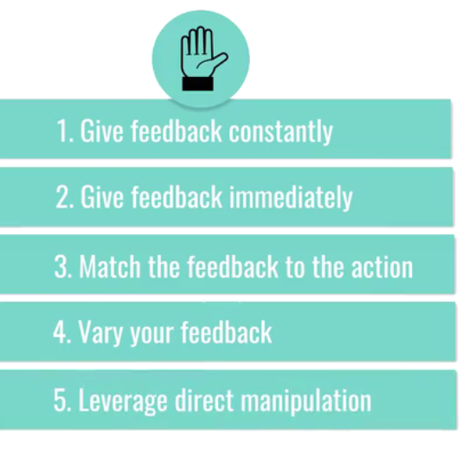
Tips to Bridge GoEva

Slide 47
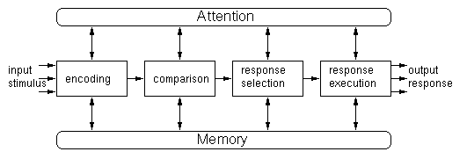
Information Processing
The information processing model provides a basis from which to make predictions about human performance.
Hypotheses can be made about how long someone will take to perceive and respond to a stimulus (also known as reaction time).

Slide 48
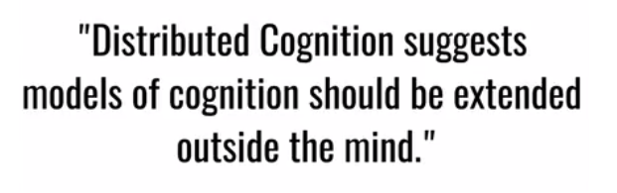

Distributed Cognition
Example : Add two big numbers

Slide 49
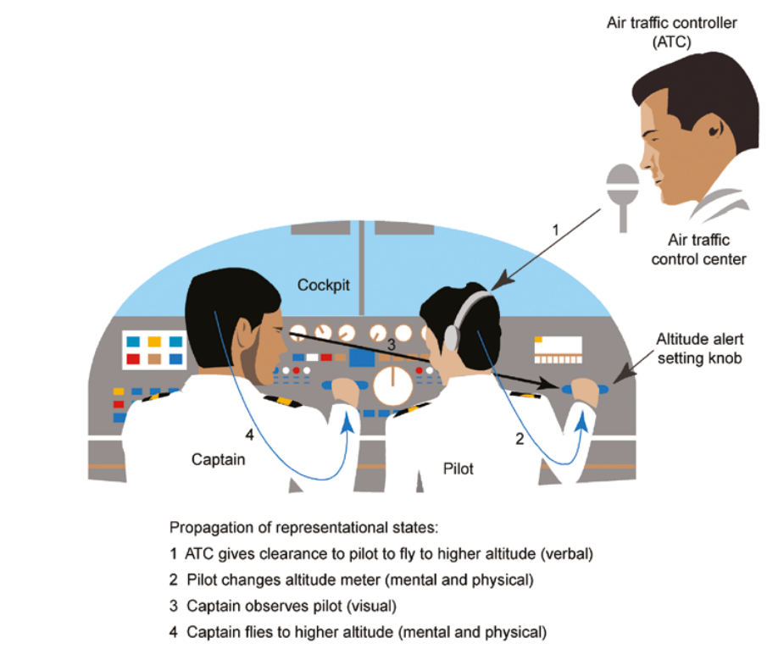
Example

Slide 50
External Cognition
External cognition is concerned with explaining the cognitive processes involved when we interact with different external representations such as graphical images, multimedia, and virtual reality.
Externalizing to reduce memory load
Computational offloading
Annotating and cognitive tracing

Slide 51
Conclusion
Cognition
Components of Cognition
Frameworks

